Slide 1
IBM University Engagement Project Submission
“Exploring the Power of Agentic AI with IBM Granite and LangFlow”

Slide 2

Project Tile – [Investment Analyst Agent]
Domain of Project – Finance
Student Name | Recent Passport Photo | Email ID | Mobile number [WhatsApp]
Vibhav Pralhad Mahishi |  | vibhavmahishi@gmail.com | +918766415237

Slide 3
Problem Statement -
Problem Statement : Investment Analyst
The Challenge
Investment analysts need to process financial information—company reports, stock performance, market news, financial indicators, and analyst opinions. Much of this information is scattered across sources and requires collection, validation, comparison, and analysis to support informed investment decisions. Manual financial research is time-consuming and prone to errors. The challenge is not just to collect market information but to automate analytical tasks that generate practical and data-driven investment insights.
The Objective
Build an AI-powered Investment Analyst Agent that delivers data-driven financial insights and investment guidance for individuals, investors, and financial professionals. The solution should:
Automate Data Gathering– Collect financial information from company reports, stock exchanges, market data, and trusted news sources.
Perform Financial Analysis– Extract KPIs, calculate financial ratios, analyze trends, and evaluate company performance.
Generate Investment Insights– Detect financial risks, analyze market sentiment, identify trends, and provide forward-looking recommendations.
Coordinate Sequential Tasks– Execute data gathering, validation, analysis, competitor comparison, risk detection, and recommendation tasks sequentially and present investment summaries, trend indicators, risks, and actionable insights through a visualization dashboard.

Slide 4
Proposed Solution -
Proposed Solution: AI-Powered Investment Analyst Agent
The proposed solution is a multi-agent AI-powered Investment Analyst Agent built using LangFlow, IBM watsonx.ai, and Granite Models to provide data-driven investment insights. The system addresses challenges in financial research, market analysis, and investment decision-making through an intelligent, structured architecture.
At its core, the solution uses a Retrieval-Augmented Generation (RAG) pipeline to fetch accurate financial information from trusted sources such as company reports, stock exchanges, and market news feeds. This data is embedded and stored in a vector database, enabling the system to retrieve and summarize financial metrics, market developments, and analyst insights using Granite models.
The system follows four key sequential tasks:
Data Gathering Task retrieves and summarizes company financial reports, stock performance data, and relevant market information.
Financial Analysis Task extracts KPIs, calculates financial ratios, identifies trends, and evaluates company performance.
Market Intelligence Task compares competitors, analyzes market sentiment, and identifies industry developments, opportunities, and risks.
Investment Recommendation Task combines validated insights to generate forward-looking observations, risk indicators, and actionable investment recommendations.
The solution includes a user-friendly dashboard built with Streamlit or React that visualizes financial trends, key performance indicators, risk levels, market sentiment, and investment summaries.
LangFlow is used to orchestrate sequential workflows, while watsonx.ai ensures model deployment, embeddings, and AI governance. Granite models power reasoning, summarization, comparison, and intelligent insight generation.
Overall, this solution delivers an end-to-end intelligent investment assistant that improves financial analysis through automated workflows, structured insights, predictive observations, and data-driven investment recommendations.

Slide 5
Technology Used
1.IBM watsonx Orchestrate – For designing, building, and orchestrating the sequential Investment Analyst Agent workflow and automating financial analysis tasks.
2.IBM Granite Model – For natural language understanding, financial reasoning, summarization, analysis, and generating data-driven investment insights.
3.IBM Cloud – Provides reliable, secure, and scalable infrastructure to deploy and operate the Investment Analyst Agent efficiently.
4.IBM watsonx.ai – For AI model capabilities, embeddings, reasoning, and AI governance.
5.IBM Bob – Used to build and develop the interactive website and user interface for the Investment Analyst Agent.

Slide 6
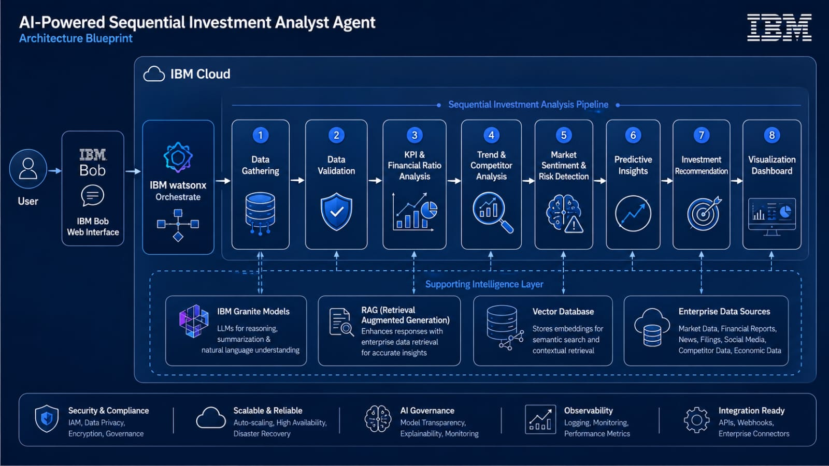
BLUEPRINT-

Slide 7
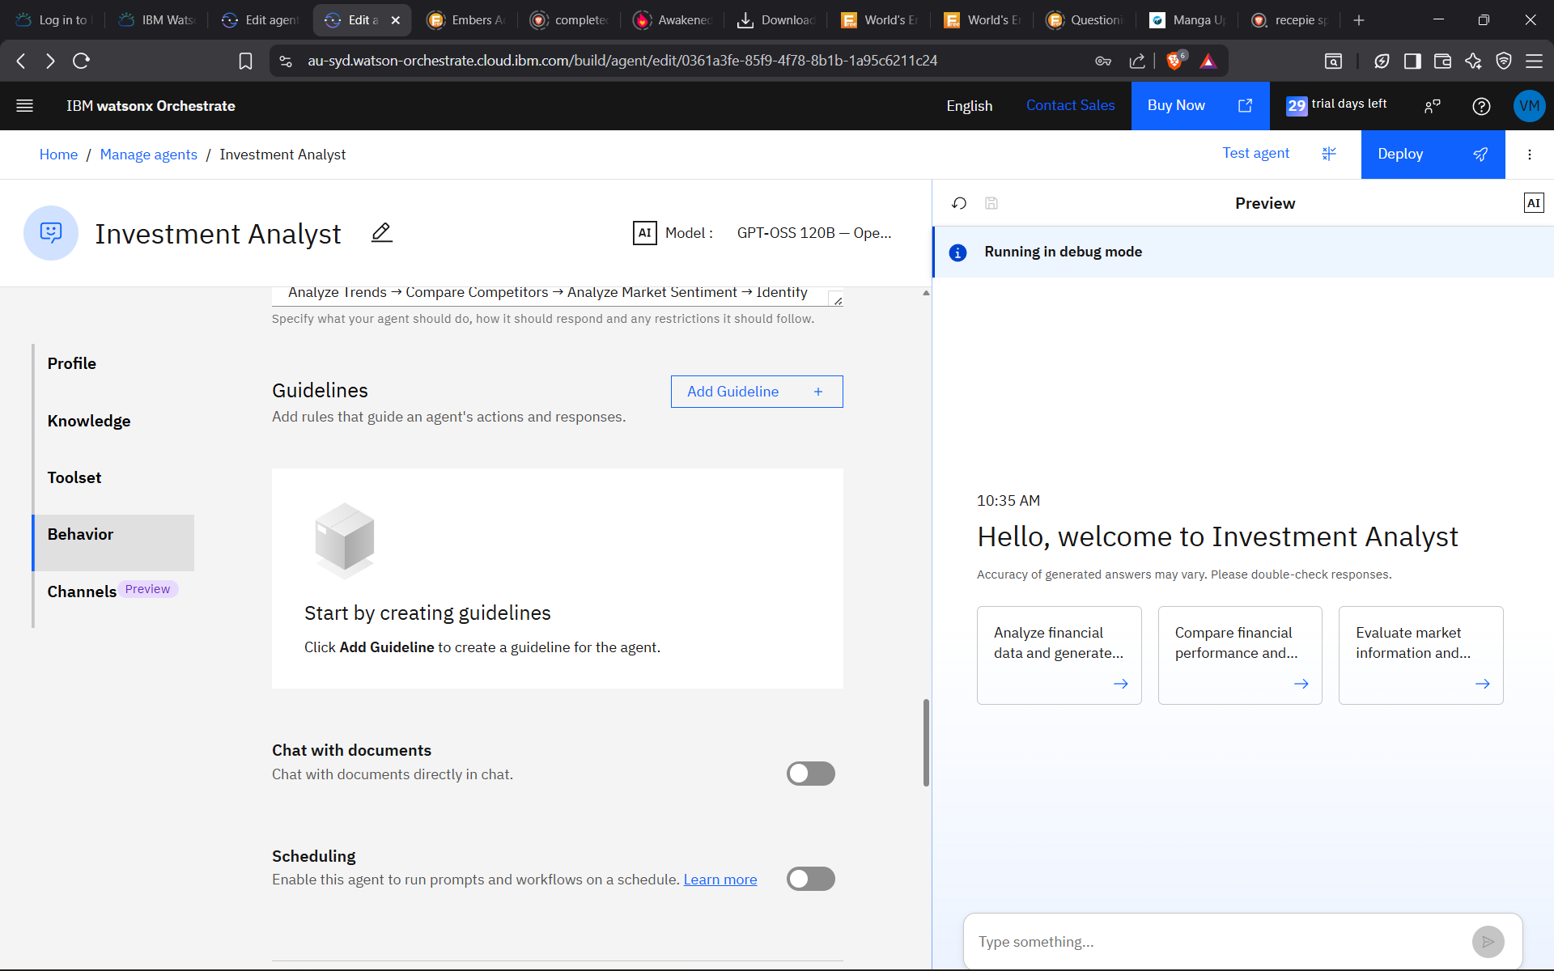
Orchestrate workflow -

Slide 8
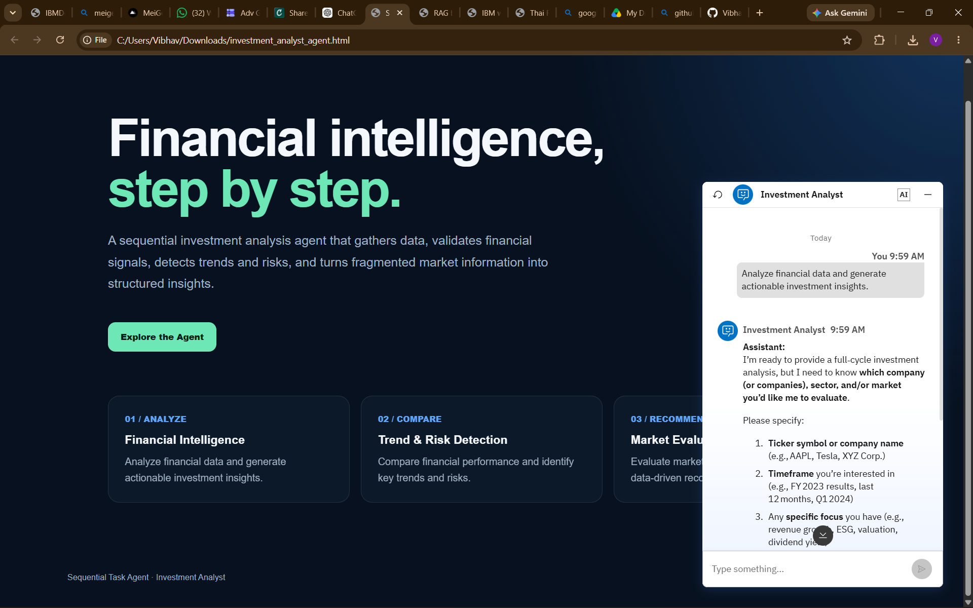
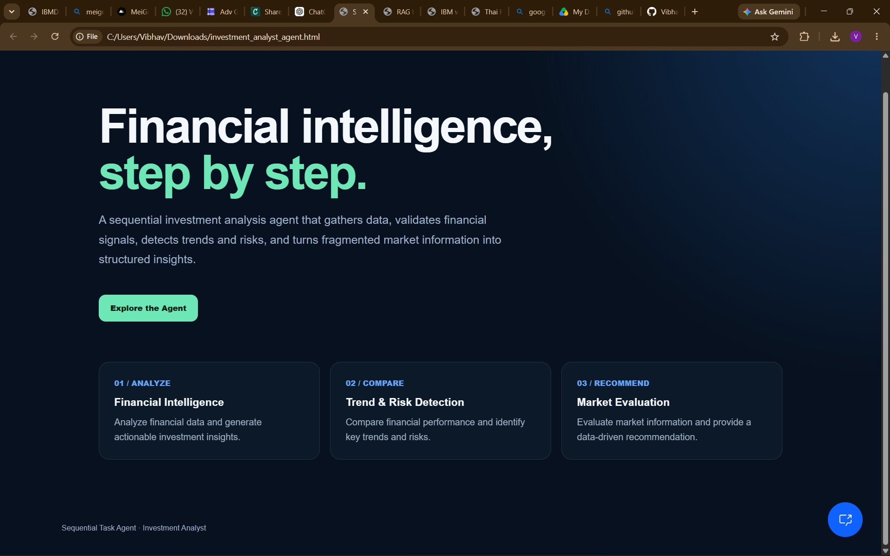
Agent Website -

Slide 9

Role of Agentic AI in the solution
Role of Agentic AI in Investment Analyst Agent
Agentic AI enables the Investment Analyst Agent to function as an intelligent, autonomous system rather than a simple chatbot. Using IBM watsonx.ai and IBM Granite models, it coordinates sequential analytical tasks to deliver data-driven investment insights.
Each task performs a specific role—such as gathering financial data, extracting KPIs, analyzing market trends, comparing competitors, and identifying risks—while working sequentially. This structured approach ensures efficient task execution and accurate results.
Agentic AI also brings context awareness, understanding financial performance, market conditions, and investment objectives to generate relevant recommendations. It supports real-time adaptation, continuously updating insights based on new financial reports and market information.
Additionally, analytical tasks share validated results with each other, enabling better decision-making and improved outcomes.
Overall, Agentic AI makes the system proactive, analytical, and goal-driven, acting like a smart digital investment analyst that helps users make informed investment decisions.

Slide 10
Novelty and Uniqueness
The proposed Investment Analyst Agent stands out by combining Agentic AI, RAG, and sequential analysis into one intelligent system.
Sequential Task Intelligence – Instead of a chatbot, analytical tasks collaborate to deliver context-aware investment insights.
Data-Driven Analysis – Evaluates KPIs, financial ratios, market trends, competitor performance, and investment risks.
Real-Time Insight Loop – Continuously adapts recommendations based on reports, market news, and conditions.
Multi-Source Intelligence – Processes reports, stock data, market news, and analyst opinions for comprehensive analysis.
Predictive Investment Focus – Goes beyond summaries to identify trends, risks, and forward-looking opportunities.
Scalable & Enterprise-Ready – Built on IBM watsonx.ai with IBM Granite models, ensuring reliability and governance.
This makes the solution a smart, adaptive, and proactive digital investment analyst, not just a static financial analysis tool.

Slide 11
Git Hub Link
Please create public github repository (Enable Add README button while creating repository) with format –
Please test and Paste the working Github URL –
https://github.com/Vibhav0025/IBM-Skills-Build
·
·
·

Slide 12
Future Scope
1.Integration with Real-Time Market & Trading Platforms – The system can be integrated with stock exchanges and financial platforms to collect real-time data such as stock prices, trading volume, market indices, and financial indicators. This will enable the Investment Analyst Agent to provide more accurate and dynamic investment insights based on actual market movements and financial conditions.
2.AI-Powered Voice Assistant & Multilingual Support – Enhancing the system with a voice-enabled assistant and support for multiple languages will improve accessibility. Users can interact naturally in their preferred language, making the solution more inclusive and suitable for diverse investors, especially in regions with varied financial backgrounds.
·
·
·

Slide 13
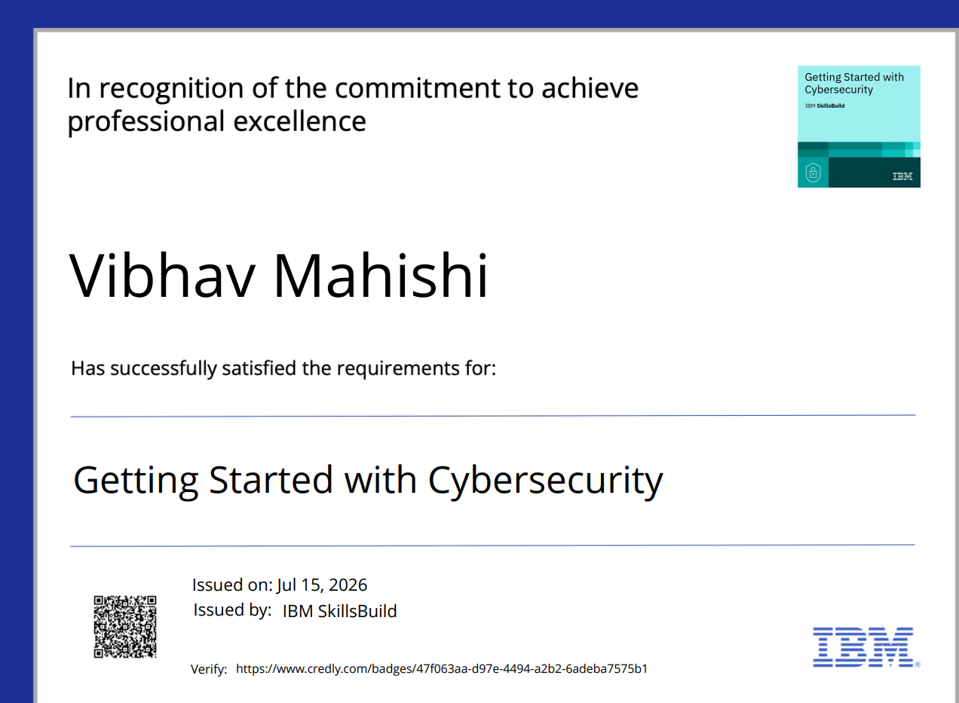
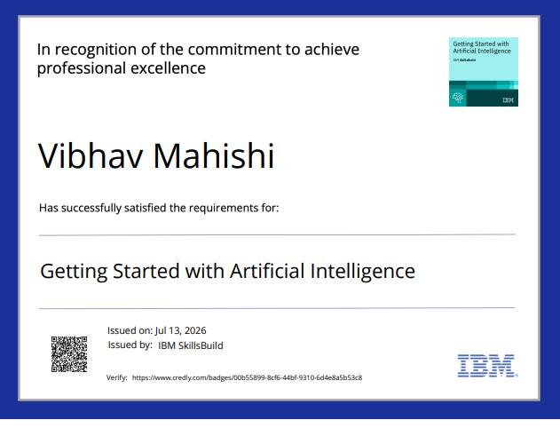
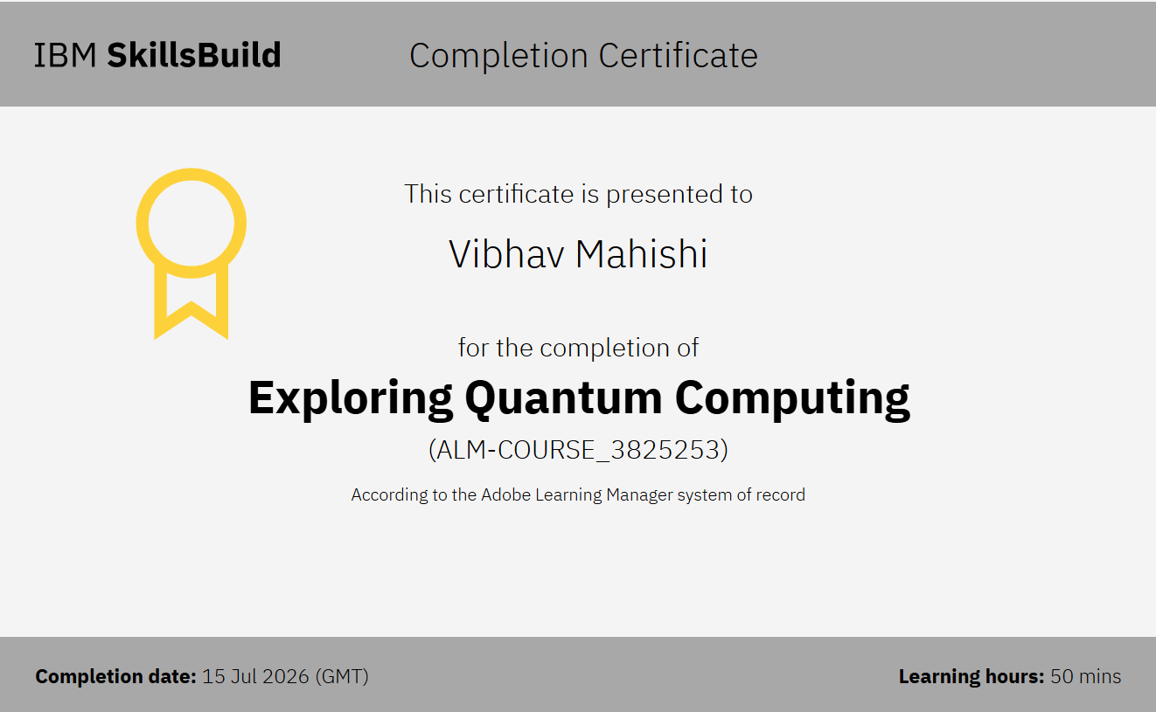
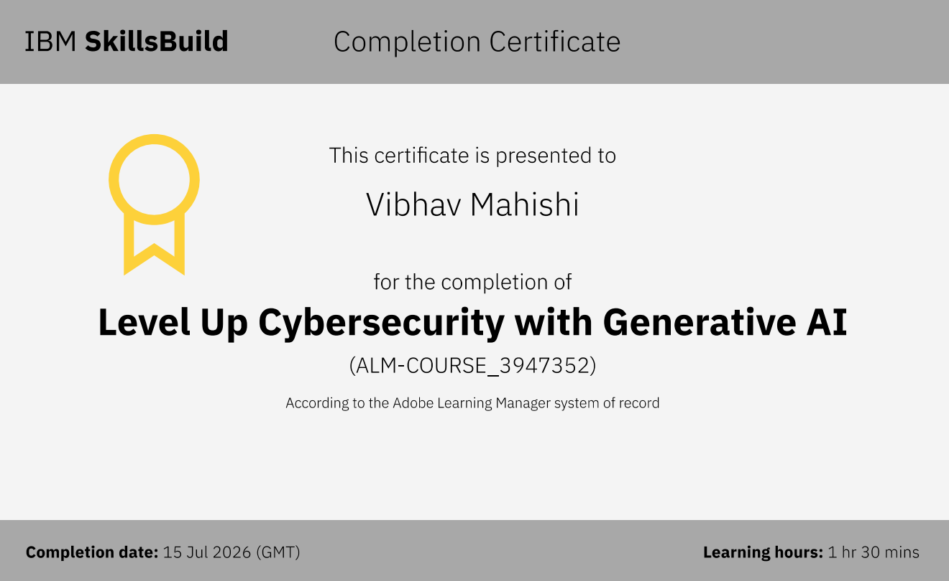
Certificates Earned:
Please add your credly certificate

Slide 14
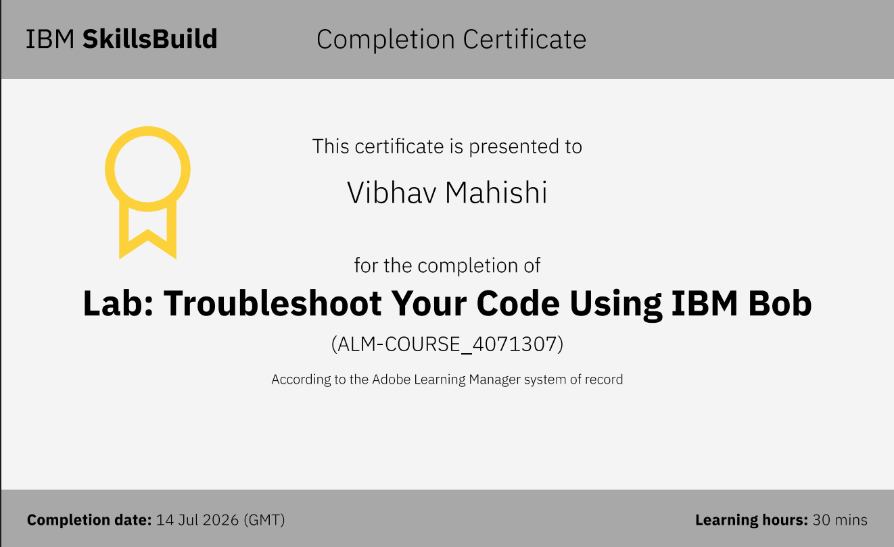
Certificates Earned:​
Add your IBM BOB Certificate

Slide 15


